Slide 1
CSC311 Midterm Review
October 14/15, 2020

Slide 2
Midterm Review
A brief overview
2. Some past midterm questions

Slide 3
Supervised learning and Unsupervised learning
Supervised learning: have a collection of training examples labeled with the correct outputs
Unsupervised learning: have no labeled examples
Regression and Classification
Regression: predicting a scalar-valued target
Classification: predicting a discrete-valued target

Slide 4
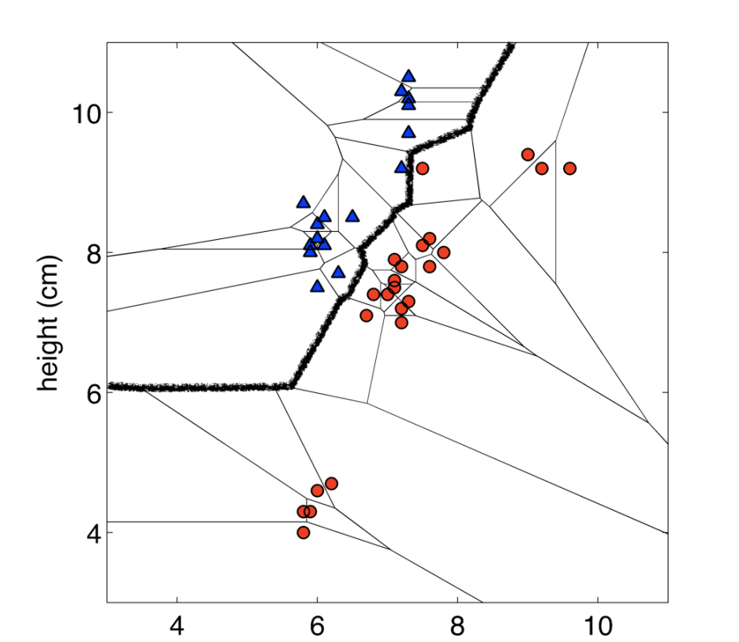
K-Nearest Neighbors
Idea: Classify a new input x based on its k nearest
neighbors in the training set
Decision boundary: the boundary between regions of input space assigned to different categories
Trade-offs in choosing k: overfit / underfit
Pitfalls:
curse of dimensionality
Sensitive to scales of input data → normalization
memory / computational cost

Slide 5
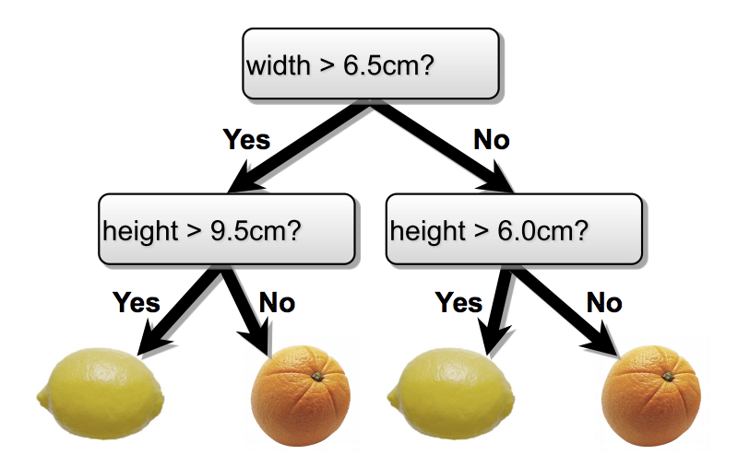
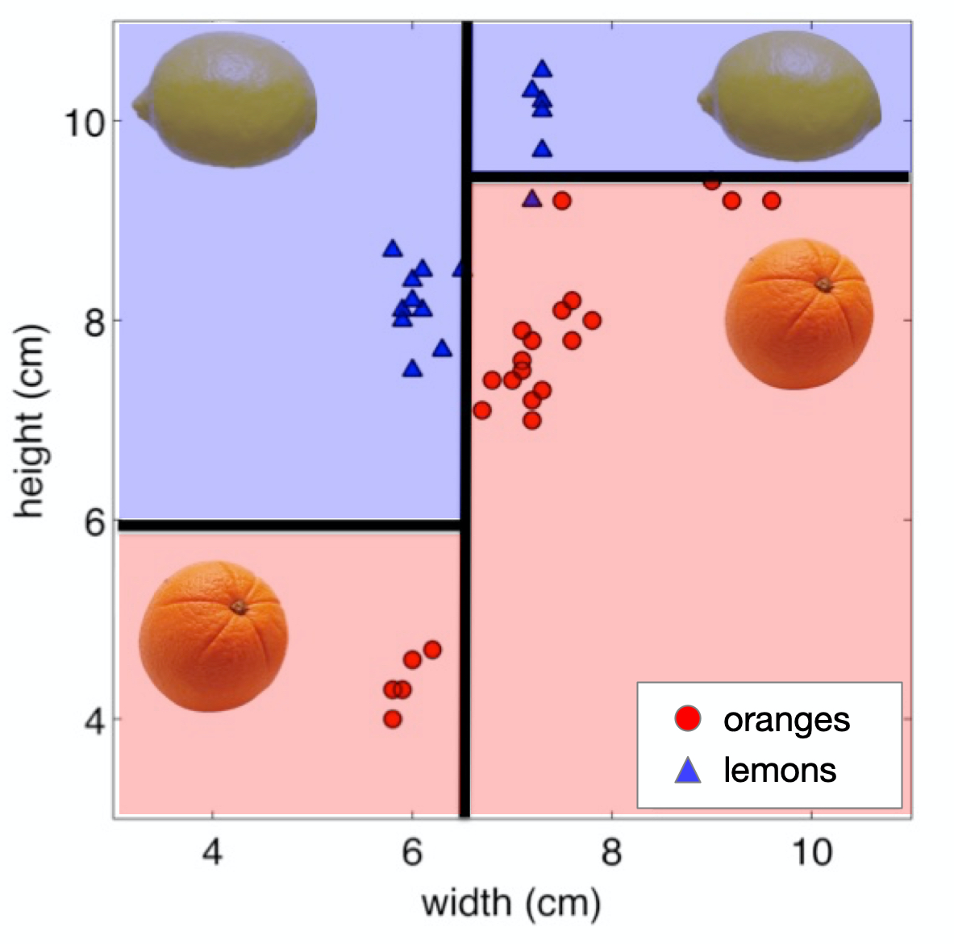
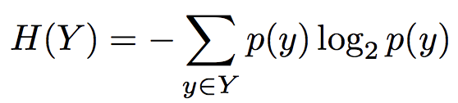

Decision Trees
Model: make predictions by splitting on features according to a tree structure
Decision boundary: made up of axis-aligned planes
Entropy: uncertainty inherent in the variable’s possible outcomes
joint entropy; conditional entropy; properties
Information gain:
measures the informativeness of a variable; used to choose a good split
Notes:
hi

Slide 6
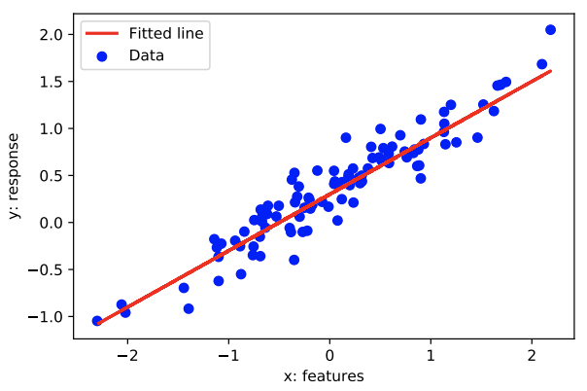


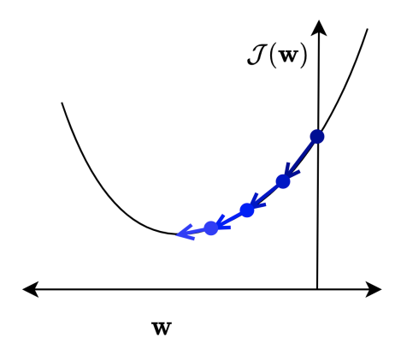
Linear Regression
Model: a linear function of the features
Loss function: squared error loss
Cost function: loss function averaged over all training examples
Vectorization: exploits efficient matrix multiplication on GPUs
Solving minimization problem: direct solution / gradient descent
Feature mapping: e.g. degree-M polynomial feature mapping

Slide 7
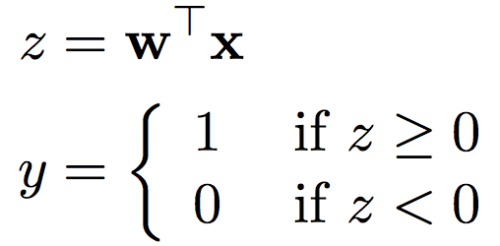
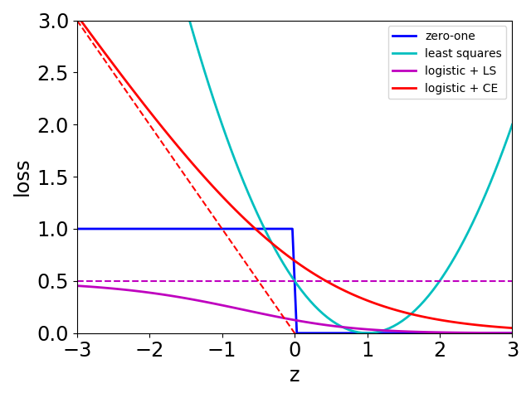
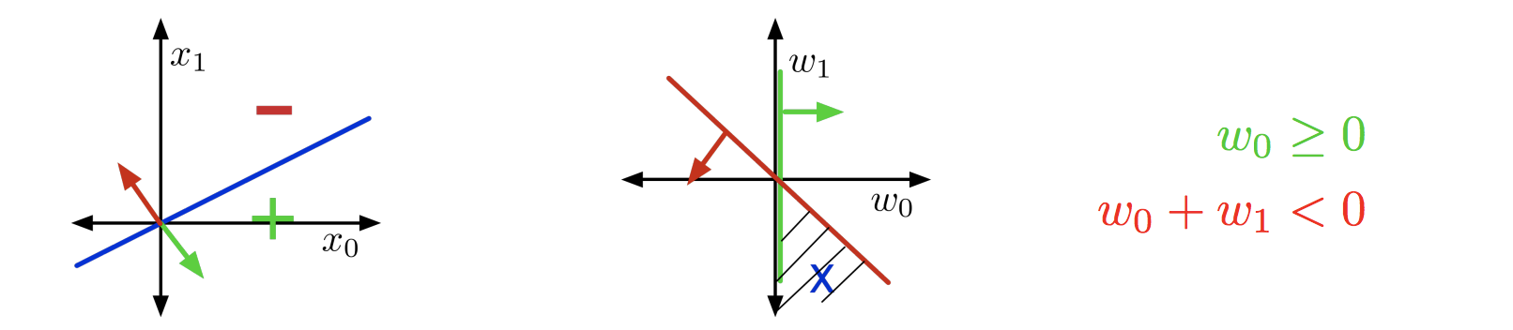
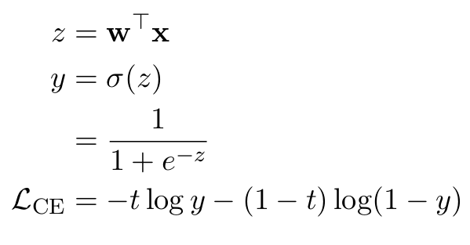
Linear Classification
Binary Linear Classification
Logistic Regression
Loss function:
0-1 loss?
Squared error loss (linear regression)?
Logistic + squared error loss?
Logistic + Cross-Entropy loss
Model:
Geometry: input space, weight space

Slide 8
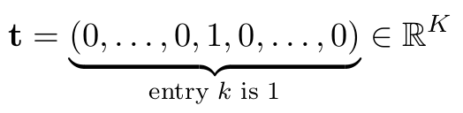

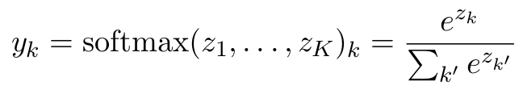
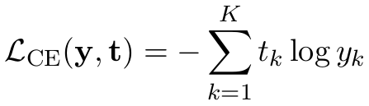

Multi-class linear classification & softmax regression
Predicting a discrete, (>2)-valued target
One-hot encoding:
Softmax regression:

Slide 9
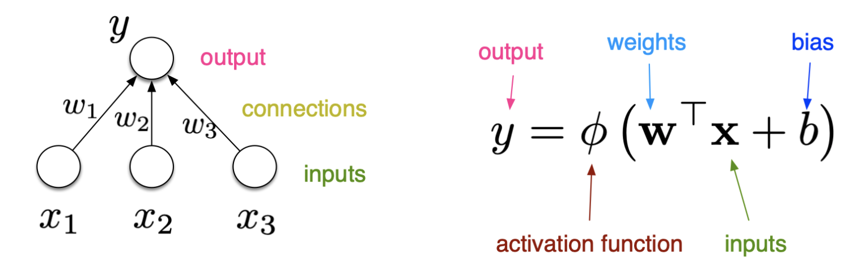

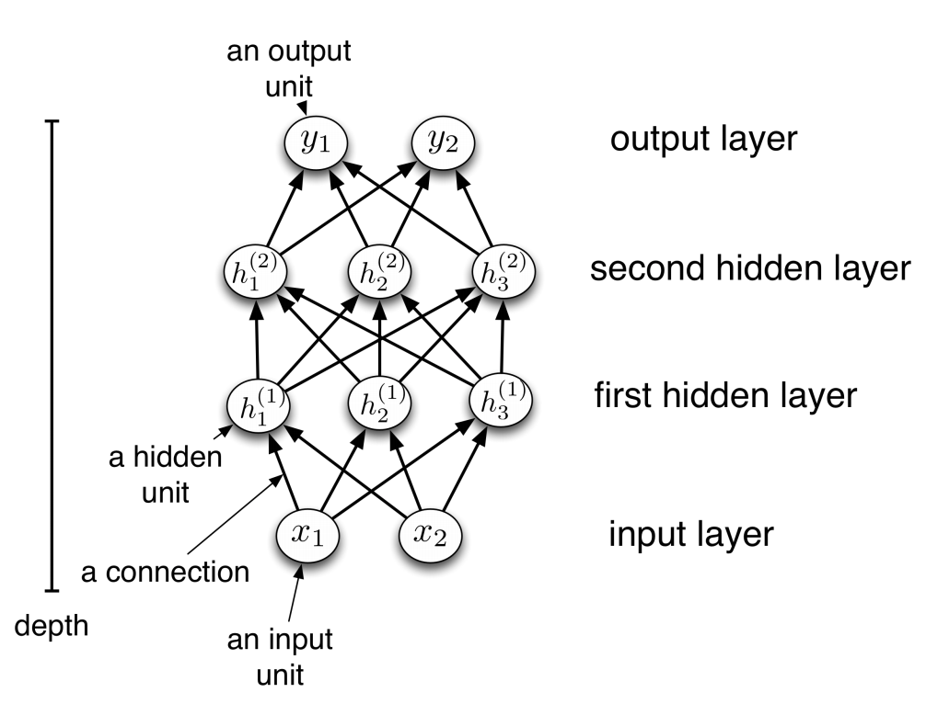
Neural Networks
Model:
Unit, layer, weights, activation functions
Each first-layer hidden unit acts as a feature detector.
Expressivity: universal function approximators (non-linear activation functions); Pros/Cons
Regularization: early stopping
Backpropagation: efficiently computing gradients in neural nets

Slide 10

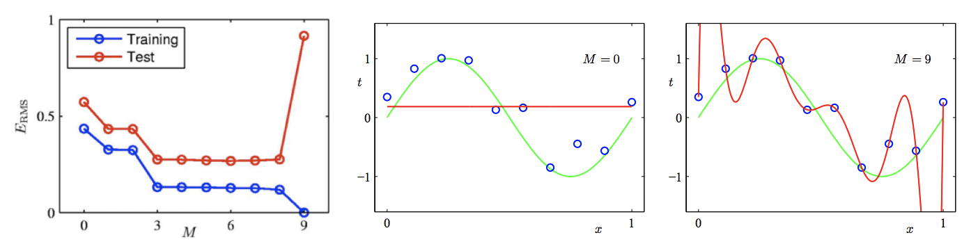
Model Complexity and Generalization
Underfitting: too simplistic to describe the data
Overfitting: too complex, fit training examples perfectly, but fails to generalize to unseen data
Hyperparameter: can’t include in the training procedure itself, tune it using a validation set
Regularization: , improve the generalization, L2 / L1 regularization
-Pattern Recognition and Machine Learning, Christopher Bishop.

Slide 11
Bayes optimality
Bayes error
caused by inherent unpredictability of the targets (independent of the prediction).
An algorithm that achieves the Bayes error is Bayes optimal.

Slide 12
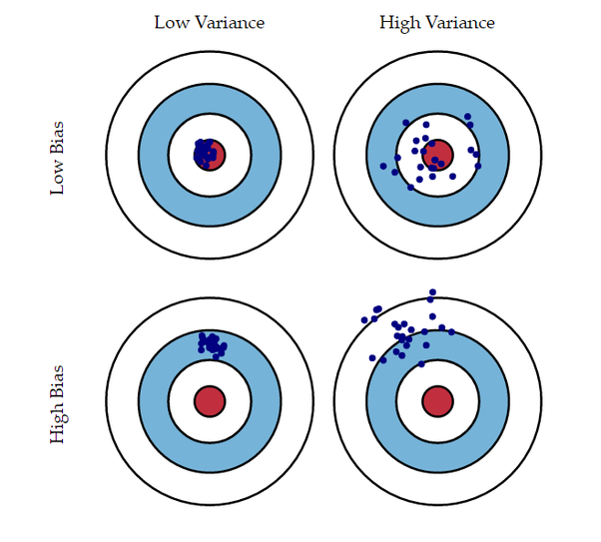

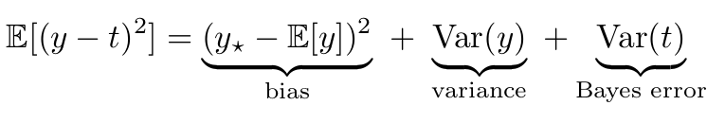

Bias-variance decomposition
For squared error loss:
Bayes optimal solution:

Slide 13
Other topics to know
Comparisons between different classifiers (KNN, logistic regression, decision trees, neural networks).
Contrast the decision boundaries for different classifiers.
Convex sets and convex functions. Use the convexity argument in proofs.
Bagging & ensembles.
Draw computation graph and use backpropagation to compute the derivatives of a loss function.

Slide 14
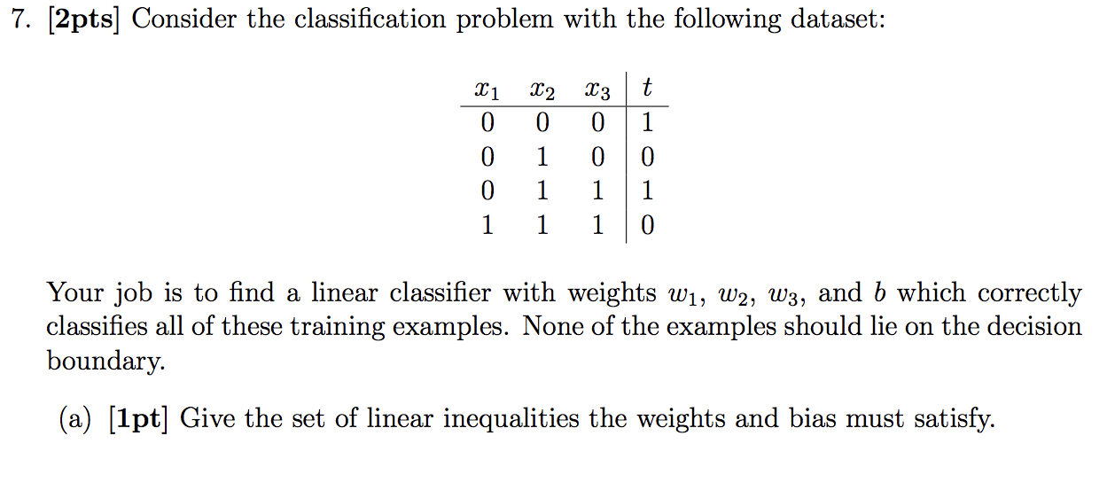
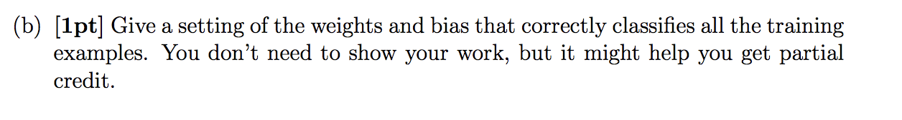
2018 Midterm Version A Q7

Slide 15
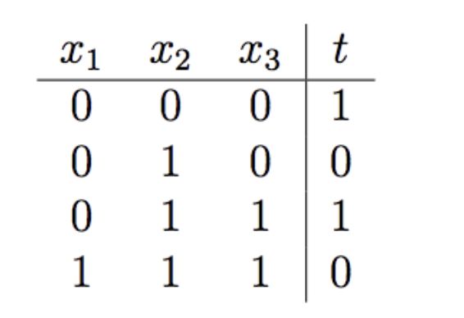

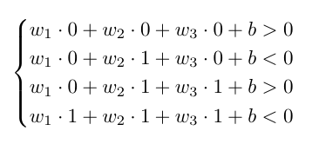
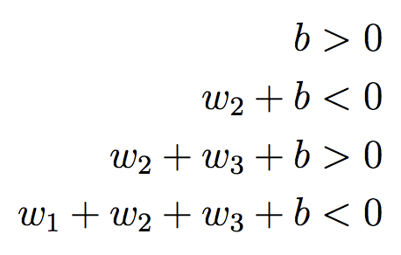
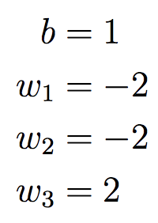

Solution
Many answers are possible. Here’s one:

Slide 16
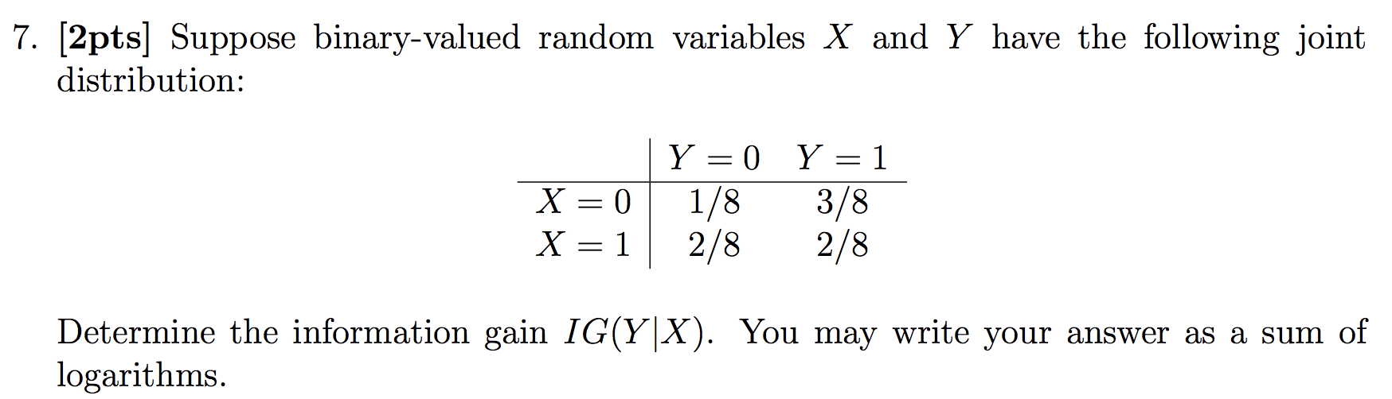
2018 Midterm Version B Q7

Slide 17

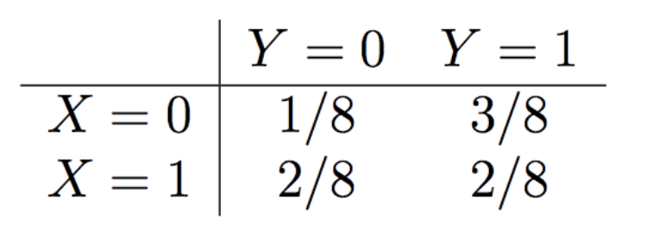
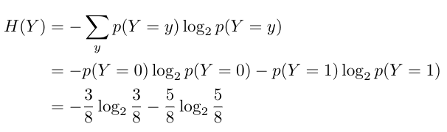
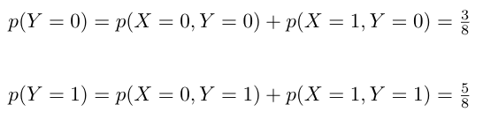
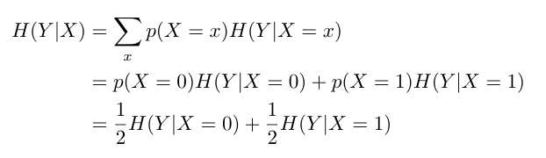
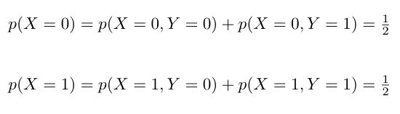

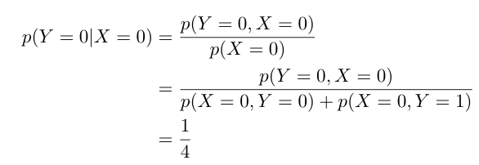
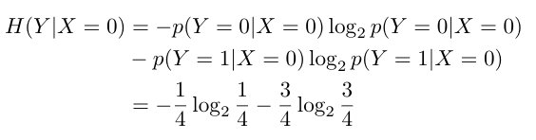


Solution

